Slide 1
Transport Layer : Primitives & Services
Prepared By: Ms. Vidhi Pandya

Slide 2
Learning objectives
To understand the location of Transport Layer in reference Model
To understand Services provided by the Transport Layer
To understand different primitives used by Transport Layer

Slide 3
Location of Transport Layer
Application Layer
Presentation Layer
Transport Service User
Session Layer
Transport Layer
Network Layer
Data Link Layer
Transport Service Provider
Physical Layer

Slide 4


Application Layer
Application Layer
Presentation Layer
Presentation Layer
Session Layer
Session Layer
Transport Layer
End to end Transmission
Transport Layer
Network Layer
Network Layer
Network Layer
Network Layer
Data Link Layer
Data Link Layer
Data Link Layer
Data Link Layer
Physical Layer
Physical Layer
Physical Layer
Physical Layer
End System
End System

Slide 5

Application Layer
Application Layer
Presentation Layer
Presentation Layer
Session Layer
Session Layer
Transport Layer
Transport Layer
Network Layer
Network Layer
Data Link Layer
Data Link Layer
Physical Layer
Physical Layer

Slide 6
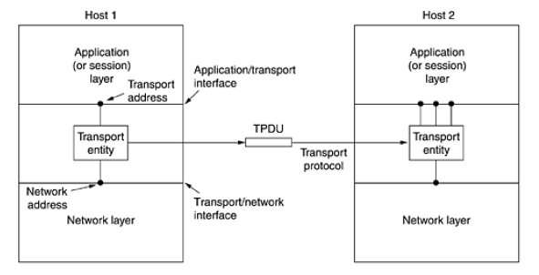
Continue …..

Slide 7
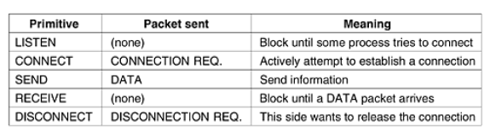
Transport Service Primitives
Connection Release – Two Ways
1. Asymmetric
2. Symmetric

Slide 8
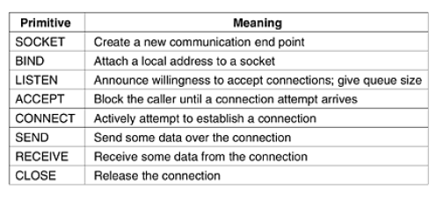
Transport Service Socket Primitives
Types of Socket– Two
1. Datagram
2. Stream

Slide 9
Services Provided by Transport Layer
Services
Addressing
Connection - Connection Less & Connection Oriented
Flow Control and buffering
Multiplexing
Crash Recovery

Slide 10
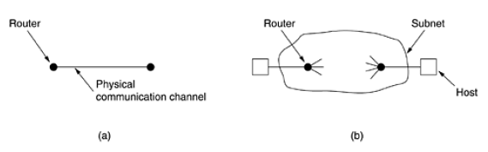
Elements of transport protocol
Specific Route
Storage Capacity
Allocation of Buffer

Slide 11
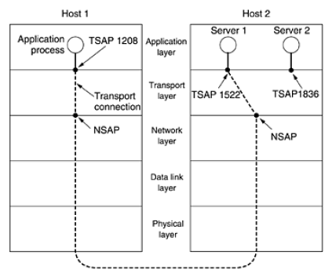
addressing
Continue …..
Port
ATM Adaptation Layer
TSAP – Transport Service Access Point
NSAP – Network Service Access Point

Slide 12
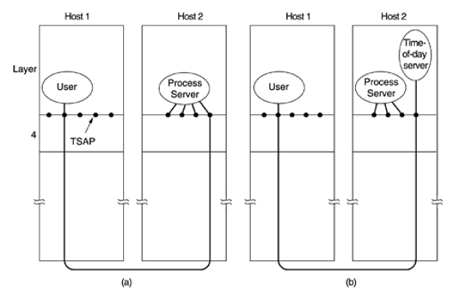
Continue …..

Slide 13
Connection establishment
Continue …..
Connection request TPDU
Connection accept TPDU
Problems :
Network Loss
Storage
Duplication of TPDU
Solution :
Provide Sequence Number
Maintain records

Slide 14
Connection establishment
Continue …..
Problem :
Machine Crash
Solution :
Restricted Subnet Design
Putting HOP counter in each packet
Timestamping each packet

Slide 15
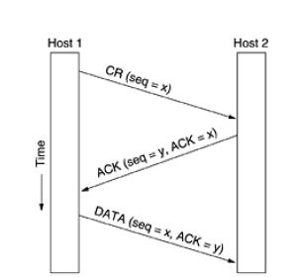
Continue …..

Slide 16
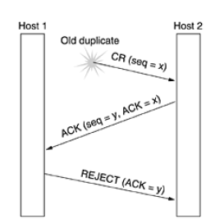
Continue …..

Slide 17
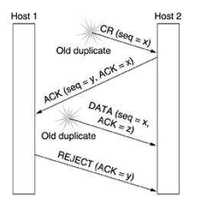
Continue …..

Slide 18
Connection release
Continue …..
Asymmetric release:
If one of the user wants to disconnect – connection disconnects
Data loss can be happened
Symmetric release
Connection must be disconnected by both the side
Consider each connection as 2 individual unidirectional connections
Data loss can be avoided

Slide 19
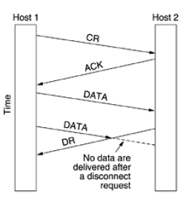
Continue …..
Asymmetric Connection Release Scenario

Slide 20
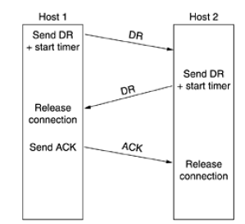
Continue …..
Symmetric Connection Release Scenario

Slide 21
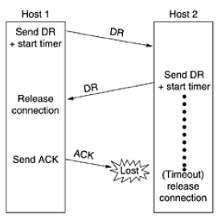
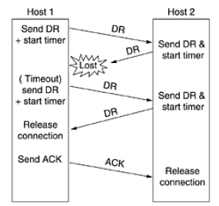
Continue …..

Slide 22
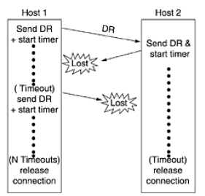
Continue …..

Slide 23
Flow control and buffering
Continue …..
Depends on the speed,
Type of connection
Buffer at Sender Side
Buffer at Receiver Side
Size of Buffer
Chained fixed size buffers
Chained variable size buffers
One large circular buffer per connection

Slide 24
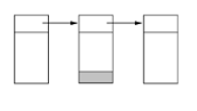
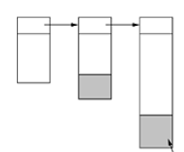
Continue …..
Chained Fixed size Buffers
Chained Variable size Buffers
Unused space

Slide 25
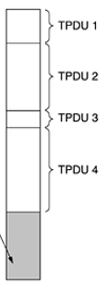
Continue …..
One large Circular buffer per connection
Unused space

Slide 26
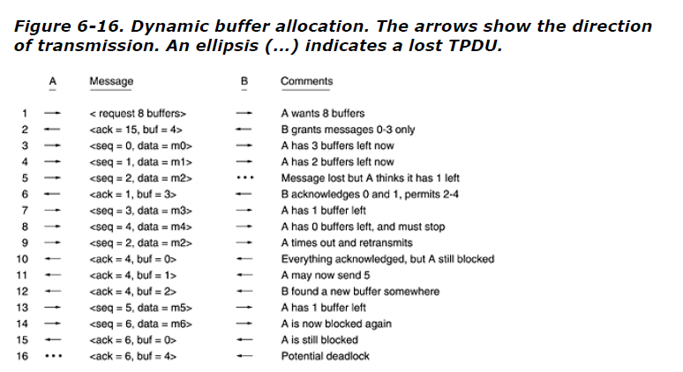
Continue …..
Dynamic Buffer Allocation
Solution - Sliding Window Mechanism + Carrying capacity of subnet

Slide 27
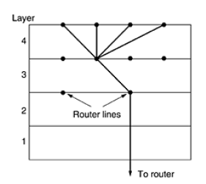
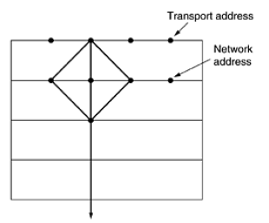
multiplexing
Continue …..
Upward Multiplexing
Downward Multiplexing

Slide 28
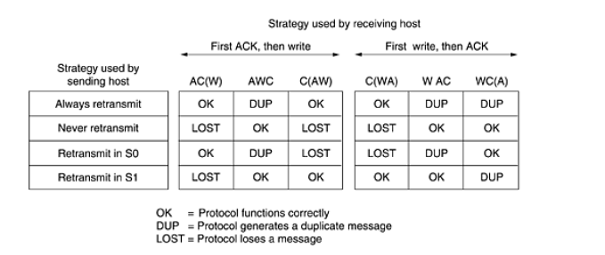
Crash Recovery
Continue …..
A – Acknowledge
W – Write
C - Crash

Slide 29
Reference Book: Computer Networks 4th edition Andrew s. tanenbaum

